Slide 1
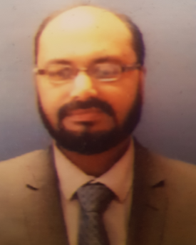
Farrukh Mirza
Senior Solution Architect/Manager
Email: Farrukh.Mirza@boi.com
Mobile: +353-87-2719767
Web: https://farrukhmpk.github.io
LinkedIn: www.linkedin.com/in/dr-farrukh-mirza
GitHub: https://github.com/farrukhmpk
Selected Experience
Since 2019
Senior Solution Architect, TST, Bank of Ireland, Dublin
Solution/System/Software Architecture
Process Automation
DevOps & Developer Experience
2013-2019
Solution Architect/Team Lead/Manager, Client Solutions Ltd, Dublin
Solution/System/Software Architecture
Team Leadership & Management
Project Management & Delivery (Agile)
Microservices & Service Oriented Architecture
Web Application Architecture
APIs (REST/SOAP)
Integration Architecture
Application/API Security
Containerization, DevOps & Tooling
Team Performance Reviews
Recruitment & Talent Acquisition
Customer Management
Professional Background
Farrukh is an experienced Solution/System/Software Architect, Manager, leader & software engineering professional with over 15 years of experience in a variety of roles including team leadership & management, and hands-on software architecture, design, development & integration experience.
Farrukh has successfully built, lead & mentored high efficiency teams by hiring excellent software development professionals and scaling existing team structures. He has successfully architected, designed & delivered web applications, highly scalable microservices, single sign-on (CAS/SAML/OAuth), thick client applications, embedded systems, ESB, JMS, SOA, distributed Web APIs, Batch Processors & automated processes in a variety of agile environments, using Java, Spring Boot, LDAP, eJabberD, scripting, PostgreSQL, MS-SQLServer, WildFly, Jenkins, Nexus, Cryptography etc.
Farrukh has been involved in integration projects over the course of his career, where he worked on different types of middleware systems.
2008-2014
Research Assistant & PhD, Trinity College Dublin
Distributed Systems
Embedded Systems & Middleware
Geo Spatial Simulator
Wireless Sensor Networks
2006-2008
Software Engineer, Hindsa Technologies Ltd, Pakistan
Extensive contribution in Agile Lifecycle Management web application using Java & Spring MVC
Selected Professional Skills & Strengths
2005-2006
Team Lead, Avanza Solutions (Pvt) Ltd, Pakistan
Lead implementation of e-Banking suite (ATM Controller and Middleware)
Developed ATM Surveillance & Biometric Fingerprint authentication software
Solution/System/Software Architecture
Web Applications, APIs, Microservices
Process & Operations Automation, Containers, DevOps & Tooling, Cloud
Qualifications
Doctor of Philosophy (PhD), Computer Science, Trinity College Dublin
Postgraduate Diploma (PGD) in Statistics, Trinity College Dublin
Bachelor of Science, Computer Engineering, Pakistan
Software Design, Development & Analysis
Team Leadership, Project Management (Scrum/Kanban)

